Slide 1

Agenda
Welcome!
Agenda
NCUA Regulation 701.4
Accounting and Finance principles
Balance Sheet
Income Statement

Slide 2
Agenda- continued
7. Key Ratios- What to watch
Spread Analysis- How does a credit union work?
Understanding and Managing Risk
10. Conclusion

Slide 3

New Regulation
701.4 of the NCUA Rules and Regulations was
amended in December 2010 to add clarity to the
duties of FCU directors.
Specifically, the NCUA added a new financial literacy requirement.

Slide 4
What’s required?
Beginning this year, every director must have a
“working familiarity with basic finance and
accounting practices”….
A Credit Union Policy to spell out the training, knowledge and expectations for board members.
A Written Plan for each board member that explains how they will accomplish this requirement.

Slide 5
Every Director must develop:
The ability to read and understand a FCU’s
Balance Sheet and Income Statement, along with
The ability to “ask, as appropriate, substantive
questions of management and the internal and
external auditors”.

Slide 6
When is this due?
All FCU directors must receive basic financial
literacy training by this July (2011).
Every new FCU director must receive basic financial literacy within six months of his or her election or appointment to the board.

Slide 7
Accounting and Finance Principles
Every transaction that takes place at the credit union is captured by the computer system in the General Ledger.
Every transaction will have a least one Debit and one Credit entry recorded.
Every transaction entry must result in Debits equaling Credits.

Slide 8
Accounting and Finance Principles
All of these GL Accounts contribute to a major category on the Financial Statements.
Income and Expenses are recognized in the period that they’re generated. Accruals allow you to record the income regardless of whether the payment is received.

Slide 9
Balance Sheet
The Balance Sheet or Statement of Financial Condition lists the Assets, Liabilities, Savings and Equity accounts of a credit union.
It’s a “snapshot in time”, showing the financial state of the credit union, on a specific date such as a month end or year end.

Slide 10
Balance Sheet
Formula:
Assets= Liabilities plus Equity

Slide 12

Assets
Assets are things of value a credit union owns.
Loans to Members
Cash
Investments
Buildings
Equipment and Furniture

Slide 13
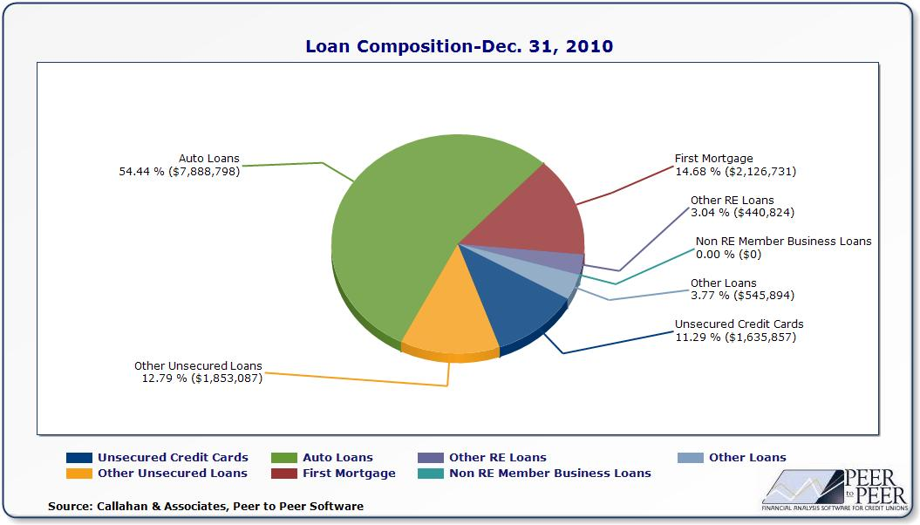

Slide 14
Allowance for Loan Loss
Is a Contra-Asset, or has a negative balance and allows us to re-value our loan portfolio to it’s proper value.
We calculate what the balance should be by looking at our historical losses over the past couple of years.
Historical loan losses are broken down by each different loan type.
02-CU-09 NCUA letter

Slide 15
Investments
Must be adjusted to market value.
Most can be sold at a premium (gain) or discount (loss).
AFS- Available for sale
HTM- Held to maturity
OTTI- Other than temporary value decline

Slide 16

Liabilities
Debts or Contract amounts owed to others.
Typically liabilities are:
Member Deposits- they loaned CU their money
Accounts Payable
Interest Payable to Members for Deposits

Slide 17
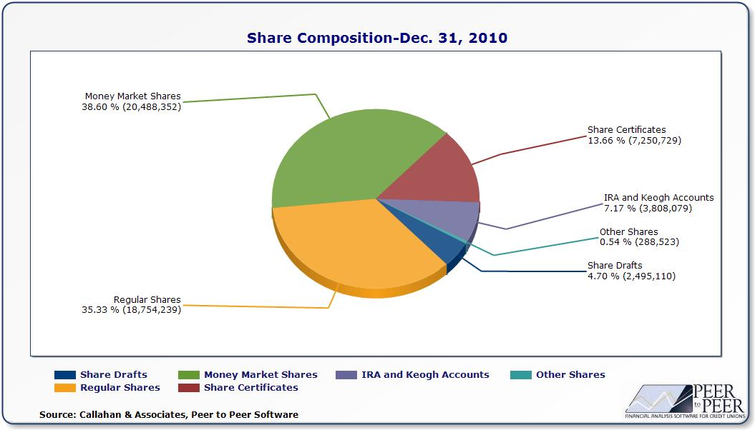

Slide 18

Member (Owners) Equity
Equity or Capital Reserves allow the credit union to absorb setbacks and losses without doing damage to its own long term viability.
Regular Reserve- can’t withdraw from
Other Reserve Accounts
Undivided Earnings

Slide 19

Income Statement
The Income Statement or Profit and Loss Statement, as it is sometimes called, contains the credit unions income and expenses over a specific time period.
It is prepared on a monthly basis and shows if the credit union is earning a net profit or income.

Slide 20
Income Statement
Formula:
Income less Expenses= Net Income or Net Loss

Slide 22
Income Sources
1. Interest Income
Loan Income
Investment Income
2. Non- Interest Income
Fee Income
CUSO Income
Non Operating Income
Other Income

Slide 23
Expenses
1. Cost of Funds- Member dividends on deposits
2. Operating Expenses
Office Operations
Salary and Benefits
Building, Equipment and Furniture
Education
3. Loan Loss Provision

Slide 24
How do we make money?
Profitability Formula
  +Yield on Loans
  +Yield on Investments
  Cost of Funds on Member Deposits
  = Net Spread (Interest Margin)
  +Fee Income
  Operating Expenses
  Allowance for Loan Loss
  = ROA

Slide 25
Key Financial Ratios
A ratio is simply a mathematical relationship between two numbers.
Most ratios and trends are based on the financial information contained in the credit union’s financial statements.
Ratios are important to management and volunteers because they map out the financial progress of the credit union.

Slide 26
Key Financial Ratios
CAMEL Ratios- CAMEL is an NCUA acronym for Capital, Asset Quality, Management, Earnings and Liquidity
Ratios are generally a percentage and not a dollar figure. The advantage of a ratio is that it is effective regardless of the size of the credit union.

Slide 27
Capital-Net Worth ratio
All the earnings of the credit union, since it’s creation are accumulated in the Capital accounts.
It’s the rainy-day fund to help weather losses.
We’re non-profits, but we need income to build our capital ratio to ensure our long term viability.

Slide 28
Capital-Net Worth ratio
This Capital ratio is used to determine the financial health of a credit union. Historically, over 7% Net Worth classifies as “Well Capitalized”.
All Reserve Accounts (except for Allowance for Loan Loss)
Assets

Slide 29
Capital-Net Worth ratio
Over 7%- Well Capitalized.
Between 6% to 7%- Adequately Capitalized
Between 4% to 6%- Undercapitalized
Between 2% to 4%- Significantly Undercapitalized
Between 0% to 2%- Critically Undercapitalized
PCA- Prompt Corrective Action

Slide 30
CU Capital Adequacy (Net-Worth Ratio)
Notes:
Credit union capital-to-asset ratios are expected to decline to 9.6% in 2010 and 2011—the lowest ratio since 1994—as capital contributions fail to keep pace
with asset growth. Capital limitations will restrict the pace of asset growth for some credit unions. These credit unions must align their asset growth to their
earnings growth to maintain their capital-to-asset ratio. To achieve this balancing act, credit unions should focus on optimal deposit pricing.

Slide 31
Delinquency ratio
This ratio indicates the strength of the credit unions loan underwriting practices and how well the credit union is controlling its loan payment process.
Delinquent Loans (over 60 days)
Total Loans

Slide 32
Charge-Off ratio
This ratio indicates the percentage of loans that have been charge off and is an indicator of loan underwriting quality and success of collection efforts. It is a “lagging” indicator of credit quality.
Loans Charged Off- Recoveries (over prior 12 months)
Average Loans

Slide 33
U.S. Unemployment & Recession
Full Employment 5%
Source: U.S. Department of Labor

Slide 34
Return on Assets ratio
Measures how well profits are being generated from the credit union’s assets.
Probably the most commonly used measurement for credit union performance.
Net Income for the Year
Avg. Total Assets for the Year

Slide 35
Net Income to Average Assets (ROA)
Notes:
One of the most important outcomes of the credit crisis is that credit unions will find it more difficult to generate sufficient earnings and capital contributions.
The big question is inflation. If it rises, the credit markets will respond with higher interest rates, which could present a significant risk for credit unions holding large positions in
long-term, fixed-rate mortgages.
A rising interest rate environment could then lead to falling credit union earnings as rising funding costs outpace sluggish increases in asset yields. This scenario
happened a generation ago and was a contributing factor to the demise of hundreds of savings and loans. It’s unlikely we’ll see a significant increase in inflation
in the next few years. But with interest rates at historic low levels today, there’s only one direction they can head tomorrow. So your credit union should be modeling
the income-statement and balance-sheet effects of a three to four percentage-point increase in interest rates during the next two to four years.
In the meantime, the current steep yield curve and strong deposit growth will be a silver lining for credit union earnings. For credit unions with strong loan demand, the
steep yield curve should increase net interest margins as they use low-rate, short-term deposits to fund longer-term, higher-rate loans.
Credit union earnings have passed their low point and will improve during the next two years. Lower loan-loss provisions, rising net interest margins, and
cost-containment efforts will boost earnings from 2009’s historic low of 15 bp.
Credit union average return on assets are expected to recover to 40 bp in 2010 and 60 bp in 2011 (before corporate stabilization expenses). Credit unions should
budget for NCUA assessments to consume 20 to 40 bp of assets for years to come.

Slide 36
Loan to Share ratio
This ratio is used to determine what percentage of our member deposits have been loaned out.
Total Loans
Total Member Deposits

Slide 37
Expense to Income ratio
This measurement calculates the credit union’s operating efficiency. It determines how successfully income is generated per expense generated.
Total Expense
Total Income

Slide 38

Other Ratios
12 Month Loan Growth- this is a year to year change in total loans.
Yield on Assets- calculates how much loans and investments are earning.
Cost of Funds- the average expense of paying your members for their deposits.
Net Interest Margin- shows the ability to manage interest rate spread and pricing.

Slide 39
Risk Management
One of the fundamental roles of the Board of Directors is to assess the level of risk faced by the credit union and to oversee the management of risk by the CEO and management.
We are in the “Risk” business. Every loan and investment has a degree of risk associated with it.

Slide 40
How to Mitigate Risk
Avoid the risk by installing security measures and policies to deter wrongdoers.
Reduce the risk by adopting procedures that make it difficult to invade systems.
Spread the risk by maintaining duplicate systems and records offsite.

Slide 41
How to Mitigate Risk
Transfer the risk by purchasing appropriate insurance coverage.
Assume the risk by absorbing certain types of losses as a cost of doing business.

Slide 42
Risk Management
Credit Risk
Liquidity Risk
Interest Rate Risk
Compliance Risk
Strategic Risk
Transaction Risk
Reputation Risk
Concentration Risk
02-FCU-09 NCUA letter

Slide 43
Credit Risk
It is the danger that a borrower will fail to repay the loan or interest payment.
Caused by poor underwriting, economic downturn, too many high risk loans and/or loan policies and personnel.
Mitigate by implementing a best practices risk based lending system with strong policies.

Slide 44

Liquidity Risk
Is concerned with maintaining an adequate availability of funds for loan demand, share withdrawals, accounts payable expenses, and daily corporate transactions.
Mitigate with a strong Cash Flow Analysis, ALM program, Policy guidelines and What-if scenarios.

Slide 45
Liquidity Risk
Line of Credit at Corporate
Borrow from Corporate
Sell Investments or Loans early
Price your loans and deposits strategically
Quality ALM guidelines

Slide 46

Interest Rate Risk
The risk of loss due to rising and falling interest rates and their potential impact on the credit union’s net interest income and capital levels.
Interest rate risk focuses on the repricing speed of assets relative to liabilities. Mitigate with ALM Shock Analysis and NEV calculation.

Slide 47
Interest Rate Risk
As interest rates rise, interest rate risk can increase. This is caused by:
Deposits re-price to higher rates immediately and become more expensive.
Fixed rate loans are locked in at their original interest rate and don’t re-price to higher yields.
When rates rise, loan volumes decrease.
The combined effect can be less income from loans and more expensive deposits resulting in a lower ROA.

Slide 48

Compliance Risk
Compliance risk involves new regulations and requirements that credit unions need to comply with to avoid fines and penalties. The complexity, scope and constant flow of new regulatory guidelines increase our Compliance risk.
Mitigate by having an individual assigned to be the compliance officer. Train staff and perform tests and internal audits to ensure conformity.

Slide 49
Strategic Risk
These are caused by adverse business decisions that result from management and/or the board of directors action or inaction.
Examples of Strategic Risk include:
  Building too many new branches too quickly that the credit union ultimately can’t afford.
  Growing Assets too quickly resulting in capital decreasing rapidly.

Slide 50
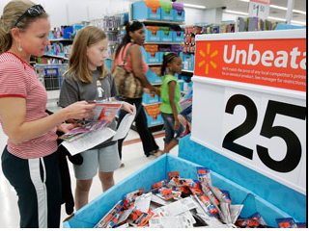
Transaction Risk
The risk of fraud or problems in transaction processing that results in the inability to deliver services to members, provide remote technology, and manage employees involved in providing services to members.
Mitigate by partnering with experienced vendors and by implementing strong internal controls. Get legal opinions and correct audit findings.

Slide 51

Reputation Risk
The risk of negative public opinion or perception leading to a loss of confidence and closed member accounts. We thrive and survive basis of public trust. Negative publicity needs to be handled quickly and effectively.
Mitigate by managing the credit union effectively and having a P/R plan ready to implement if necessary.

Slide 52
“5” Keys for success
Implement Credit Union Policy.
Prepare a Plan for each Board Member.
Review Financial Statements.
Analyze Key Ratios.
Monitor Risks.

